Slide 1
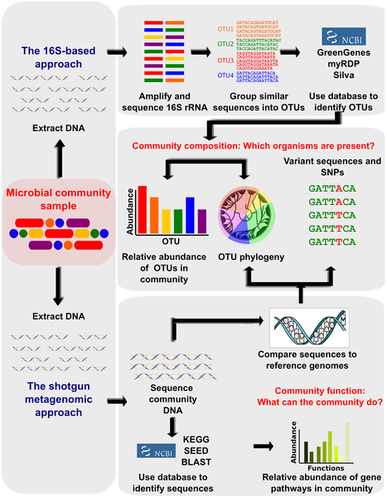
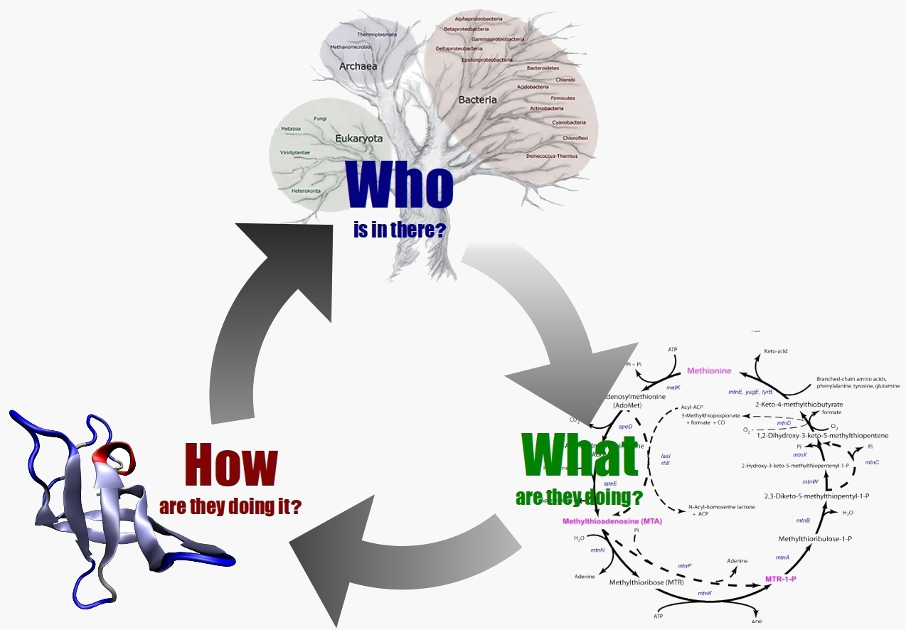
Creating an efficient compression based DNA sequence clustering algorithm for the analysis and comparison of metagenomes
Ashwin Sekar¹ Huzefa Rangwala²
¹Poolesville High School ²George Mason University
Introduction
Experimentation
Results
Conclusions
Metagenomics is the sequencing and analysis of genetic samples from the environment. Because these samples contain microorganisms never before studied or cultivated traditional analysis methods provide no insight.
The shotgun approach of using a database to identify sequences has been replaces with the 16S-based approach for this task. This approach uses databases to identify whole clusters rather than individual sequences, resulting in a higher success rate.
Using my approach I created 6 algorithms to test,
MC-Lz4DM (Metagenome Clustering using Lz4 based Dissimilarity Measurements)
MC-SeqDM (Metagenome Clustering using Sequitur based Dissimilarity Measurements)
MC-Lz4CD (Metagenome Clustering using Lz4 based Compression Distances)
MC-RLEDM (Metagenome Clustering using RLE based Dissimilarity Measurements)
MC-SeqCD (Metagenome Clustering using Sequitur based Compression Distances)
MC-RLECD (Metagenome Clustering using RLE based Compression Distances)
These algorithms were tested alongside the current leading algorithms:
MC-MinH,
MC-LSH,
UCLUST,
CD-HIT
ESPRIT
DOTUR
Mothur
Preliminary evaluation stage:
Before doing clustering evaluation, each of these algorithms were tested for the accuracy of their similarity measure. The similarity measures were compared to the ground truth similarity between uncompressed sequences measured through direct comparison.
Final Evaluation:
First the algorithms were tested using a simulated data set. The simulated data contains 345,000 short sequences, generated from 43 known 16S rRNA gene fragments using the Roche GS20 system. Since this data set is simulated, an exact OTU number of 43 is expected. However since real life data samples have processing errors, data sets with 3% and 5% error were derived from the simulated data to mimic environmental conditions.
Next the algorithms were tested on an environmental data set containing eight seawater samples taken from a study by Sogin et. Al. Samples contain unequal length sequences with average sequence length of 60 characters.
Performance Metrics:
Number of OTU’s – The number of clusters produced
Run Time – The time taken to complete clustering
Weighted Similarity – The average similarity within each cluster
Chao1 index – Overall richness of the species
ACE index – Richness of species, focused on clusters with less than 10 members
Shannon index – Measure of entropy found in the sample as a whole
According to the hypothesis, since the algorithms that the compression based approach produced were concluded to be viable clustering algorithms, we have demonstrated the computational efficiency and accuracy of the compression based approach. Therefore by combining any compression algorithm, with appropriate similarity and clustering methods, we can create a viable solution.
The success of this compression based approach has the potential to produce algorithms with serious improvements in terms of efficiency and accuracy.
When the similarity measures were tested, MC-SeqCD and MC-RLEDM were deemed to be inaccurate in comparing compressed DNA sequences.
The remaining 4 algorithms were tested alongside the industry algorithms on the simulates data set with 43 OTU’s.
MC-SeqDM and MC-RLECD were deemed to be inaccurate in judging the amount of clusters as they reported figures more than five times the actual value.
Future Work
For further testing, more algorithms created by the compression based approach need to be tested on a variety of data sets in order to assess consistency.
Test with more samples and a greater diversity in DNA sequence length
Use state of the art compression algorithms
Use varying clustering algorithms
By reducing the time and increasing the efficiency of clustering results, metagenomic clustering can be implemented in common laboratory practices allowing the easy comparison of microorganisms. Metagenomic clustering can open doors into new biological research involving microorganisms, in fields such as disease diagnostics and treatment.
Goal
The limiting factor for Metagenomics is the clustering algorithm. Current clustering algorithms do not have the speed and accuracy needed to make Metagenomics a common laboratory practice. My researched focused on creating a 3 step process which would combine common data compression algorithms with existing clustering algorithms to speed up and maintain the accuracy of these algorithms.
The goal of the research was to refine this procedure so that it could be applied to any clustering algorithm and compression algorithm to improve the efficiency and accuracy of that clustering algorithm.
The remaining two algorithms fit the criteria for the 3 step approach, so they were tested on an environmental data set. MC-Lz4DM outperforms all other algorithms in terms of weighted similarity with MC-Lz4CD in a close second. In terms of speed, MC-Lz4DM finishes fourth on average with MC-Lz4CD finishing fifth. Comparable speeds and an increase in efficiency indicates that these two algorithms are viable for clustering based on the standard metrics.
Compress the DNA Sequences
Compute Similarity between compressed sequences
Cluster the compressed sequences using the computed similarity
References
[1] Wooley JC, Godzik A, Friedberg I (2010) A Primer on Metagenomics. PLoS Comput Biol 6(2): e1000667. doi:10.1371/journal.pcbi.1000667
[2] Marco, D, ed. (2011). Metagenomics: Current Innovations and Future Trends. Caister Academic Press. ISBN 978-1-904455-87-5.
[3] Gene W. Tyson and Philip Hugenholtz. Metagenomics. Nature Reviews Microbiology, Sep 2008
[4] Morgan XC, Huttenhower C (2012) Chapter 12: Human Microbiome Analysis. PLoS Comput Biol 8(12): e1002808. doi:10.1371/journal.pcbi.1002808
The diversity metrics of MC-Lz4DM and MC-Lz4CD in comparison to MC-MinH are shown above. On average, both of my algorithms underestimate the richness of the clusters through the Chao1 index, but accurately measure the richness through the ACE index.
Both of my algorithms match MC-MinH in entropy as demonstrated by the Shannon Index. In general, my algorithms create clusters with comparable entropy and richness to the current leading algorithm indicating that both of my algorithms are viable clustering methods in terms of species diversity metrics.

